Slide 1
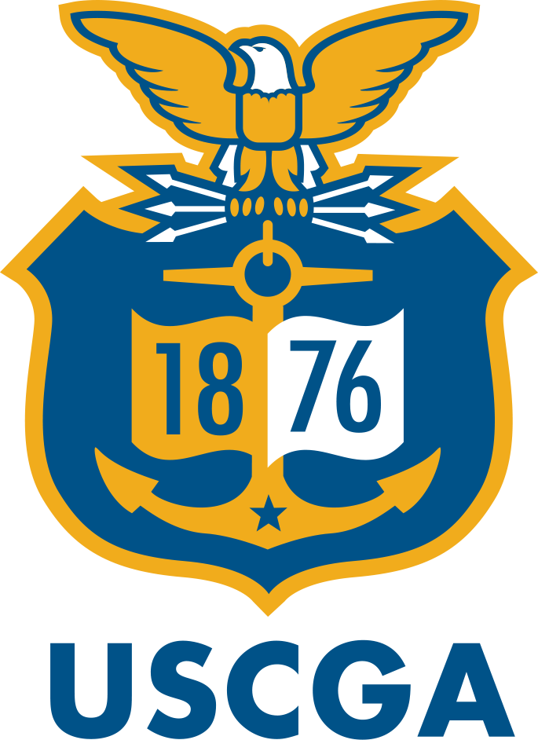
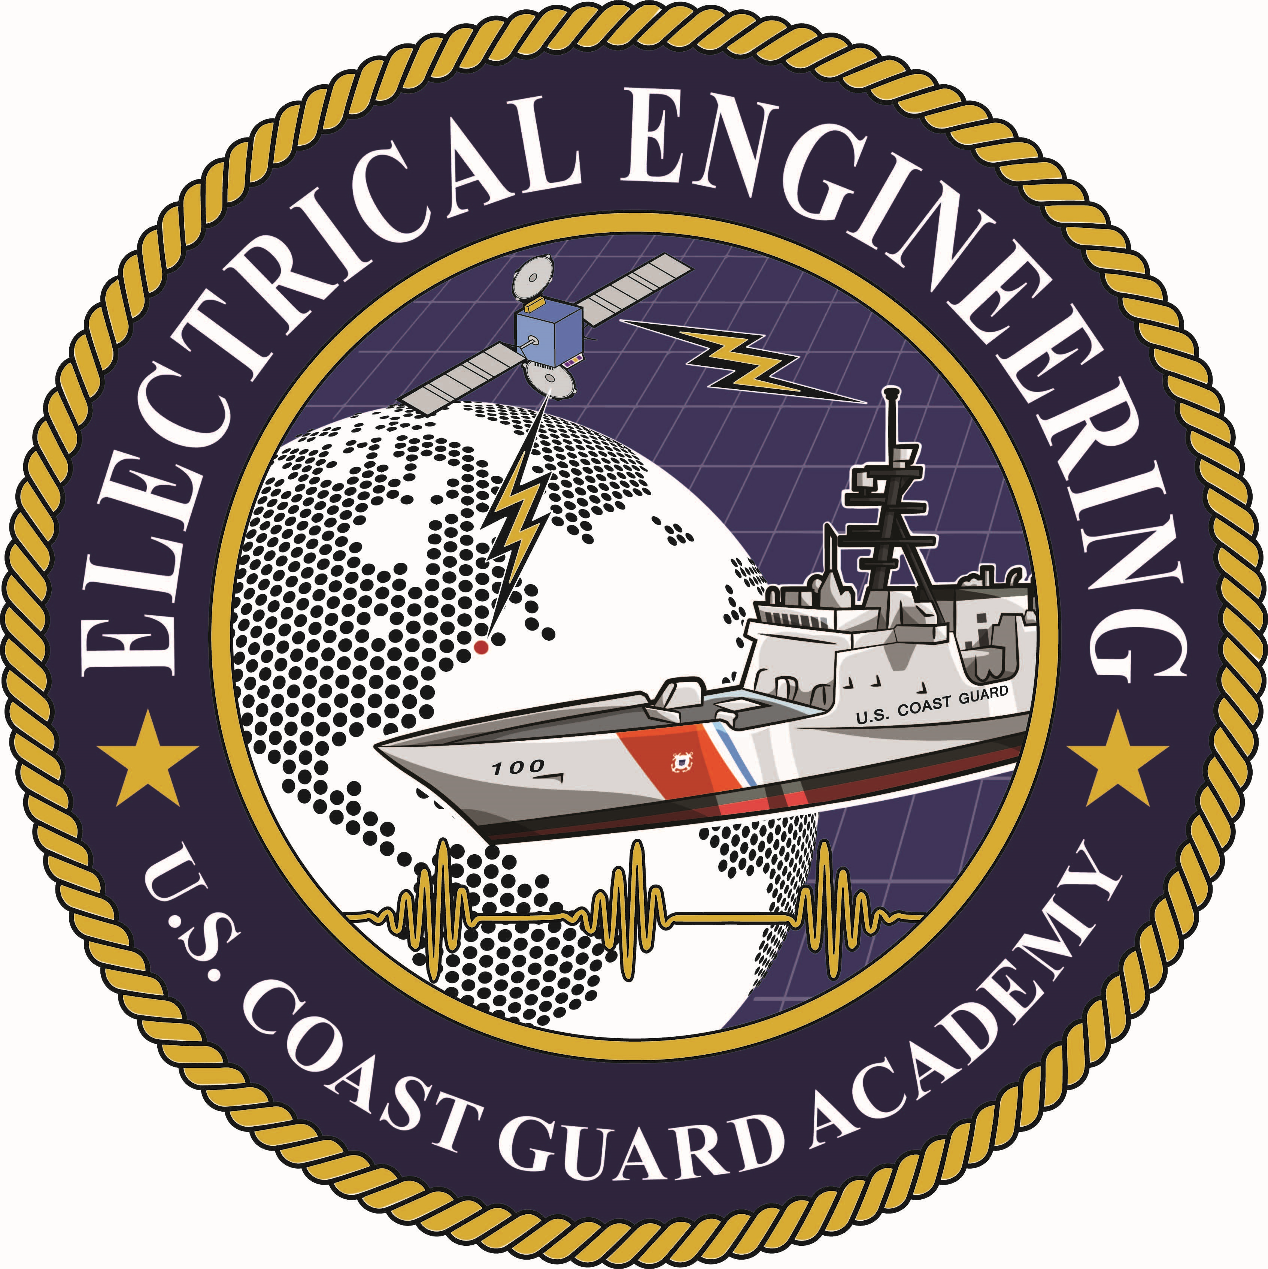
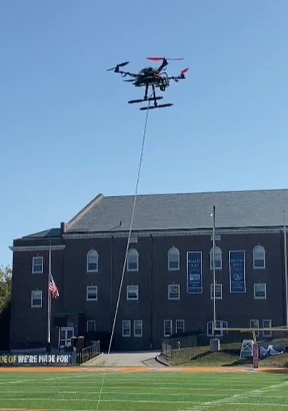
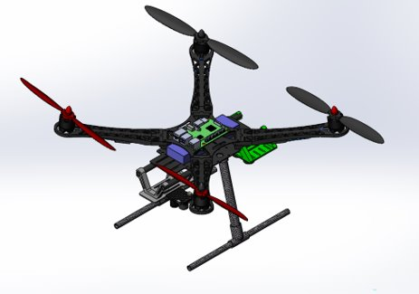
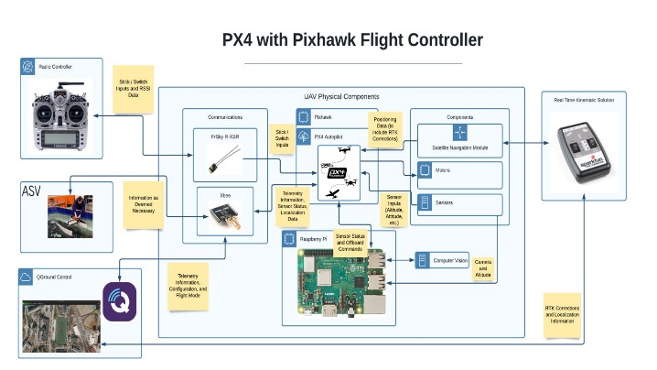
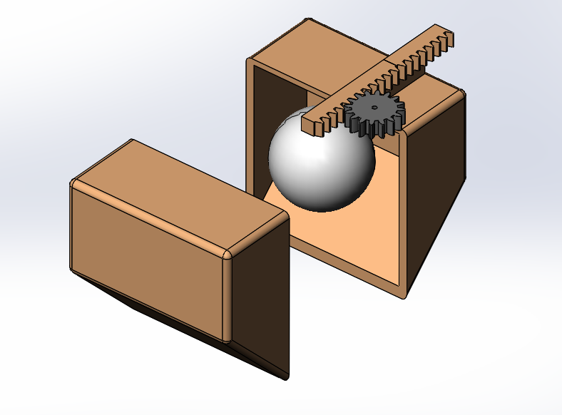
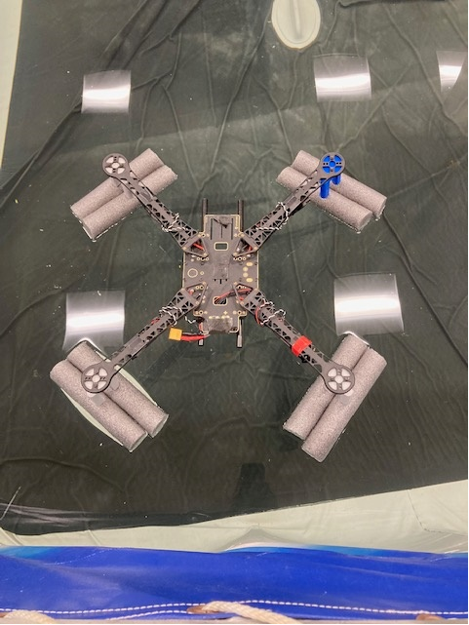
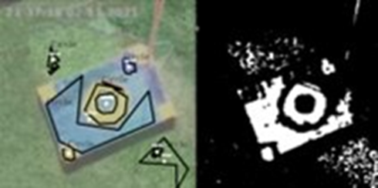
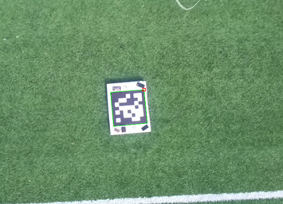
Senior Design Project in Electrical Engineering
Autonomous Unmanned Aerial Vehicle
1/c Bulone, 1/c Kim, 1/c McGahey, 1/c Meyers, 1/c Schellman, 1/c Von Brock Advisors: CAPT Hartnett, LT Blanco, ET2 Johnson, and Dr. Swaszek
Sponsors: United States Coast Guard Academy Electrical Engineering Section
Project background
Autonomous Flight
The USCG can use unmanned aerial systems in conducting many of its missions. Currently, the only drone system in the USCG is the Boeing ScanEagle which requires a dedicated pilot and launching system. The Autonomous Unmanned Aerial Vehicle (AUAV) group aims to create a new unmanned system capable of accomplishing USCG missions without a pilot, at a low cost, and deployable from any platform. To guide the design process, the group is creating a drone that aligns with the requirements laid out in the RoboBoat Competition, a yearly contest of autonomous systems.
The physical quadcopter has served as a platform for flight testing. PX4, the autopilot software, features several flight modes. User-controlled flight was utilized to tune the drone's attitude controller. GPS controlled autonomous flight demonstrated the ability to fly predetermined paths and simulated search patterns. The drone was observed to be very stable during flight, takeoff, and landing with no visible oscillations. Offboard commands were successfully tested to control the drone's velocity in the x, y, and z directions; these commands are critical to enabling computer vision-controlled flight.
System Overview
Hardware: S-500 Frame, PixHawk 2.4.8 Flight Controller, Raspberry Pi microcontroller, ZED-F9R GPS-RTK, Xbee Series 3
Software: PX4 v1.12.3, QGroundControl, Gazebo 11
Requirements
Design and build a UAV that is capable of stable autonomous flight.
Enable takeoff and landing from the Autonomous Surface Vessel.
Deliver objects to a designated platform using a mechanical system.
Coordinate objectives and communicate with the ASV.
Figure 4: Image of Final UAV Design
Payload Delivery System/Floatation
The AUAV is required to transport a ping-pong ball sized object. This is planned to be accomplished with the scoop mechanism in Figure 5, actuated by a micro-servo motor. The drone must also remain positively buoyant for at least 120 seconds in the event of a water landing. This is accomplished with the use of foam outriggers in Figure 6, providing buoyancy to the ~3 lb. drone.
Figure 1: System Block Diagram
Image Processing
The AUAV utilizes an onboard Raspberry Pi 3 equipped with a standard Pi Cam module in order to analyze a variety of factors. Creating the scripts for image processing is completed through using the Open-Source Computer Vision (OpenCV) library, which is a python library with the primary purpose of support objectives in processing images and videos for detection. The current developed scripts can identify the edges of objects based on contour identification analyzed from hue saturation values. Figure 2 displays a still from a test flight in which edge detection of a prototype landing platform was attempted. Additionally, the AUAV can identify ArUco markers, which are like QR codes, through functions available in OpenCV. The identification of objects by the camera will be necessary for providing inputs to a controller in order to autonomously land or deliver a payload to a specified platform.
Figure 5: Payload Delivery System Figure 6: Drone Float Outriggers
Results
One quadcopter has been built according to the preliminary design. The weight, flotation, and component requirements of the RoboBoat competition have been satisfied. A mesh communication network has been established on the same frequency as the ASV to facilitate future communication. Both manually controlled and autonomous flight have been successfully tested in response to significant disturbance inputs. The observed standard GPS in-flight accuracy is within 2.5 feet. A successful and stable computer-vision controlled landing was demonstrated in simulation, and the necessary real-world testing has been conducted to facilitate future testing of computer vision enabled flight.
Figure 2: Edge detection of platform test
Figure 3: ArUco marker flight still

